Slide 1
Gamers’ ROTC
Gamers’ ROTC is a media network that delivers top-tier, accurate military information and entertainment on Twitch through the jokes and antics of military veteran hosts, allowing the company to engage authentically with military fans, service members, and military veterans in the U.S.
Notes:
1. Hi, I’m Logan Nye. Thank you so much for meeting with me. I’m here to talk about a great opportunity to bring military media to livestreaming on Twitch.

Slide 2
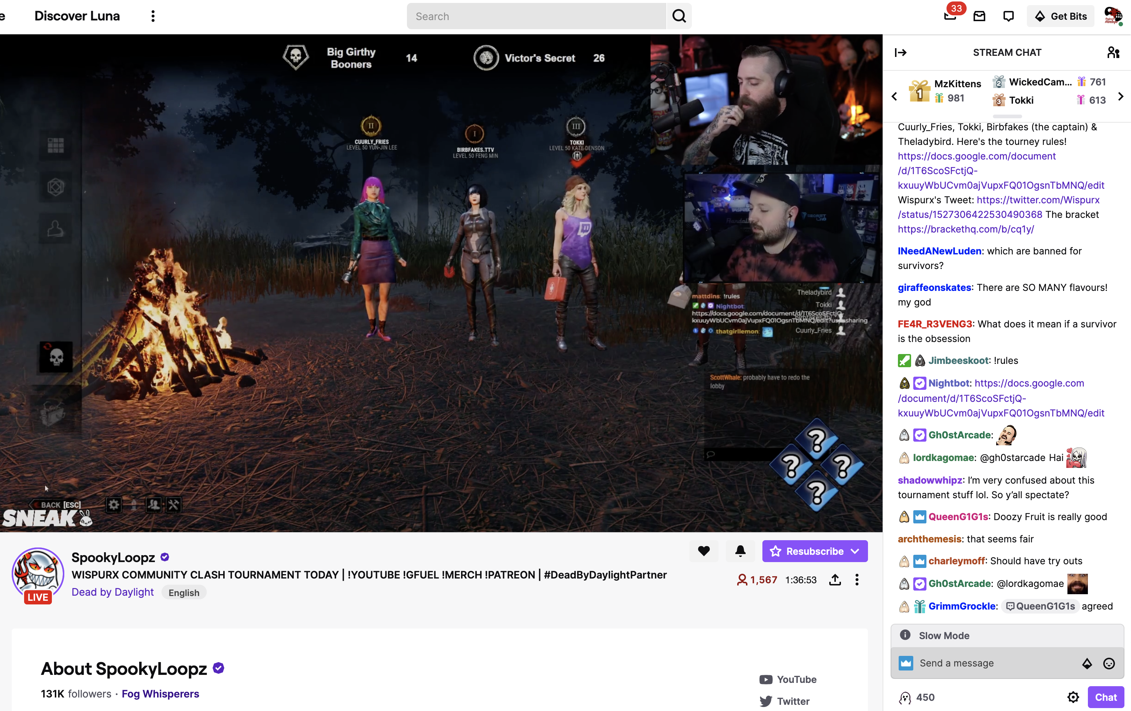
The Opportunity
Notes:
2. Twitch is an Amazon-owned platform where media companies can generate hundreds of dollars per minute in advertising revenue, if they generate the right audience and find the right advertisers. Brand-friendly creators connect thousands of viewers with large advertisers. A larger channel like that of SpookyLoopz, pictured here, can generate over $12,500 weekly in subscriptions and over $500,000 per week in ad sponsorships. Over the past two years, I have frequently met representatives from massive companies that wanted to reach a military-affiliated slice of this audience, but they have struggled to find a brand and family-friendly entry point. We are confident we can create that entry point and sherpa them in. So who are we?

Slide 3
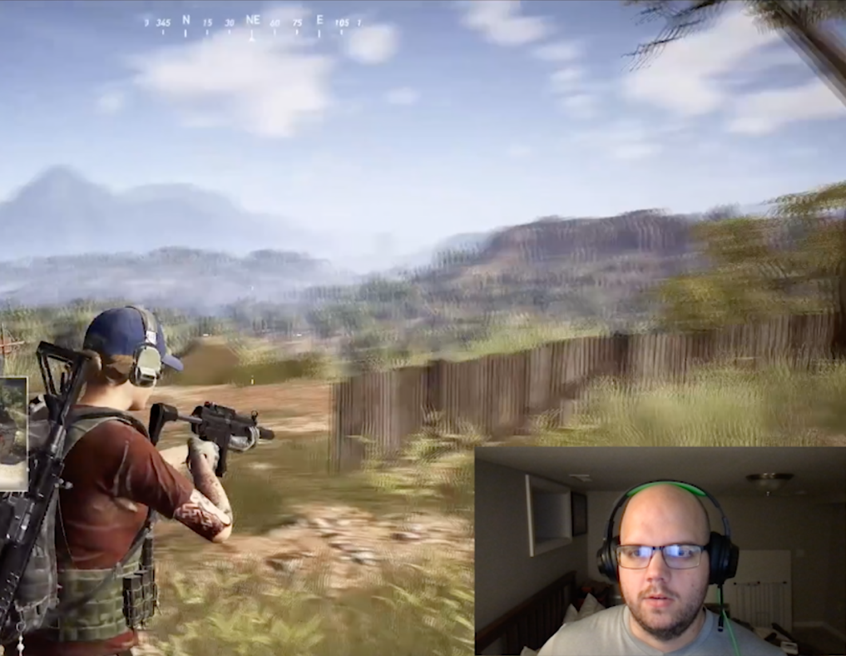
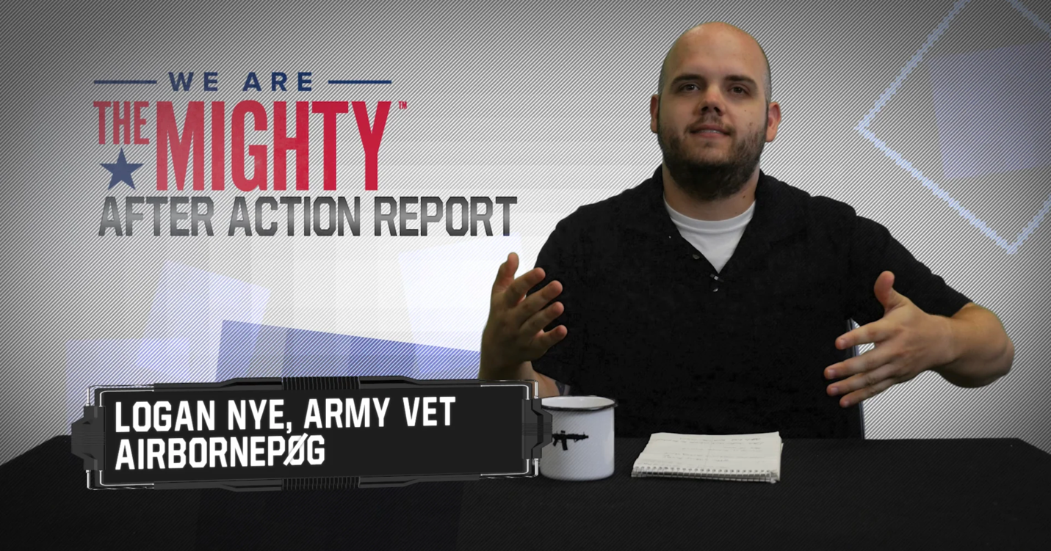
Why we can fill the gap
z
Notes:
3. Gamers’ ROTC is an infotainment multimedia company that focuses on bringing successful brands and military families together to the lucrative Twitch platform through family-friendly content. We reach military audiences where they are through podcasts, YouTube, websites, documentary appearances, and more, and direct them to our Twitch channels.

Slide 4
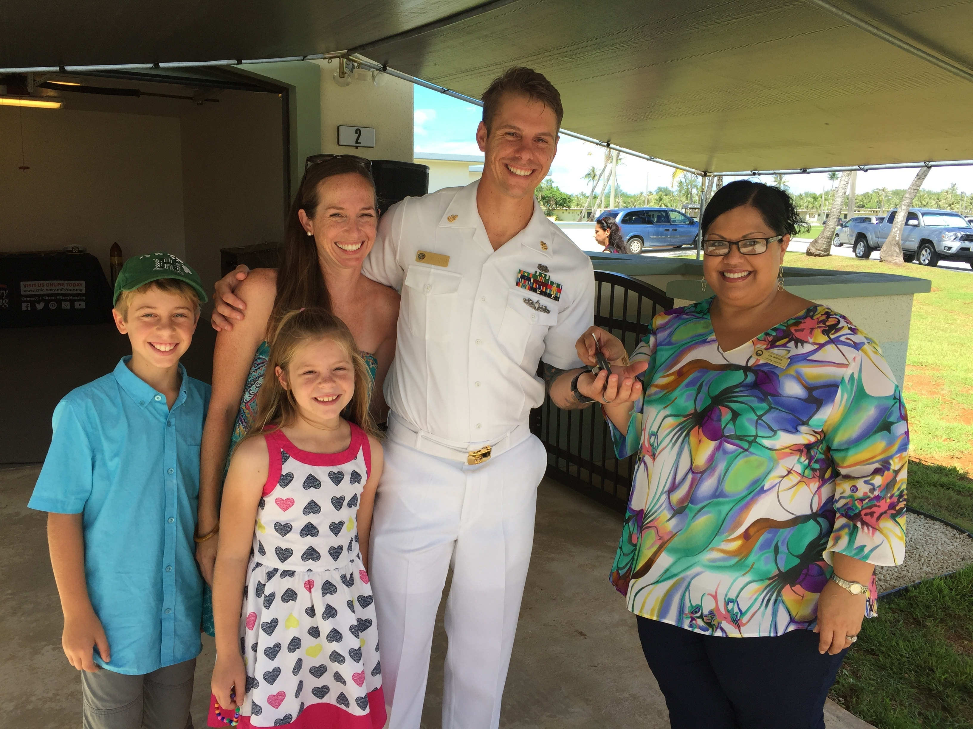
Our best audience
z
Notes:
4. For us, the audience is military fans, service members, and veterans between the ages of 18 and 34. In these ages, the military members and their families go from living at home to, often, living in the barracks to establishing homes on or near military bases. These major life events are perfect for our advertisers, especially financial institutions and consumer goods companies, as the consumers’ needs and patterns are in flux, meaning there is an opening for the companies to change their purchasing behavior.

Slide 5
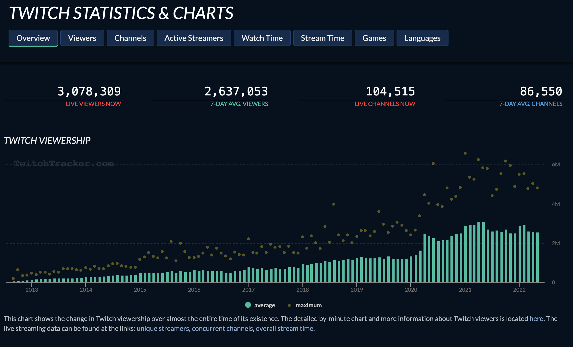
Staving off the competition
z
Notes:
5. Right now, there are very few military-aligned Twitch channels, except for veterans playing military video games. There are, however, literally tens of thousands of channels that our audience can choose from. Keeping them on our channel requires careful stewardship of the community and attracting viewers who will connect with and support one another. We expect that military members, used to doing this in their units and profession, will naturally help us create a great, “sticky” community that will ensure strong audience retention.

Slide 6
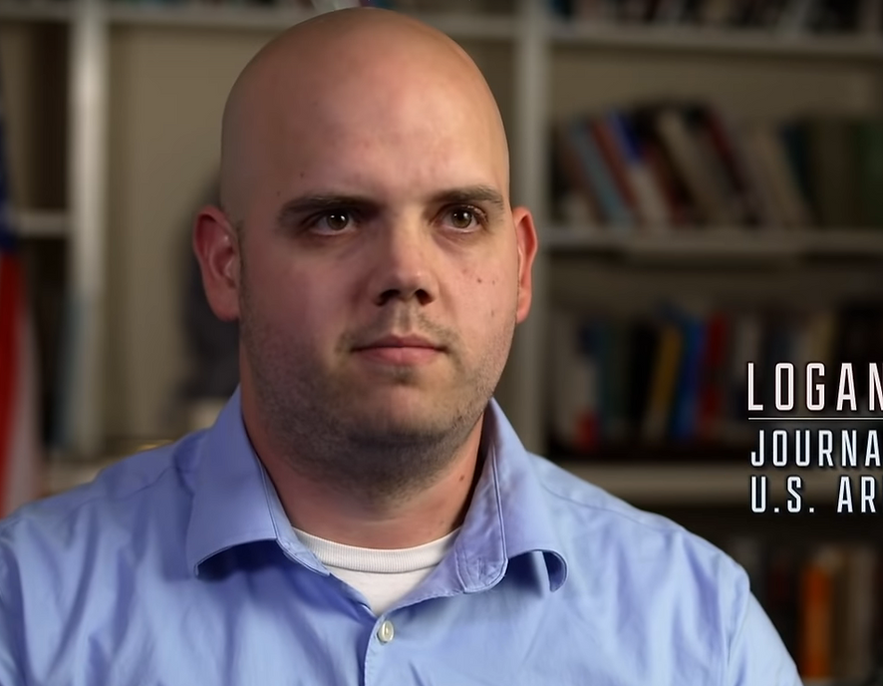
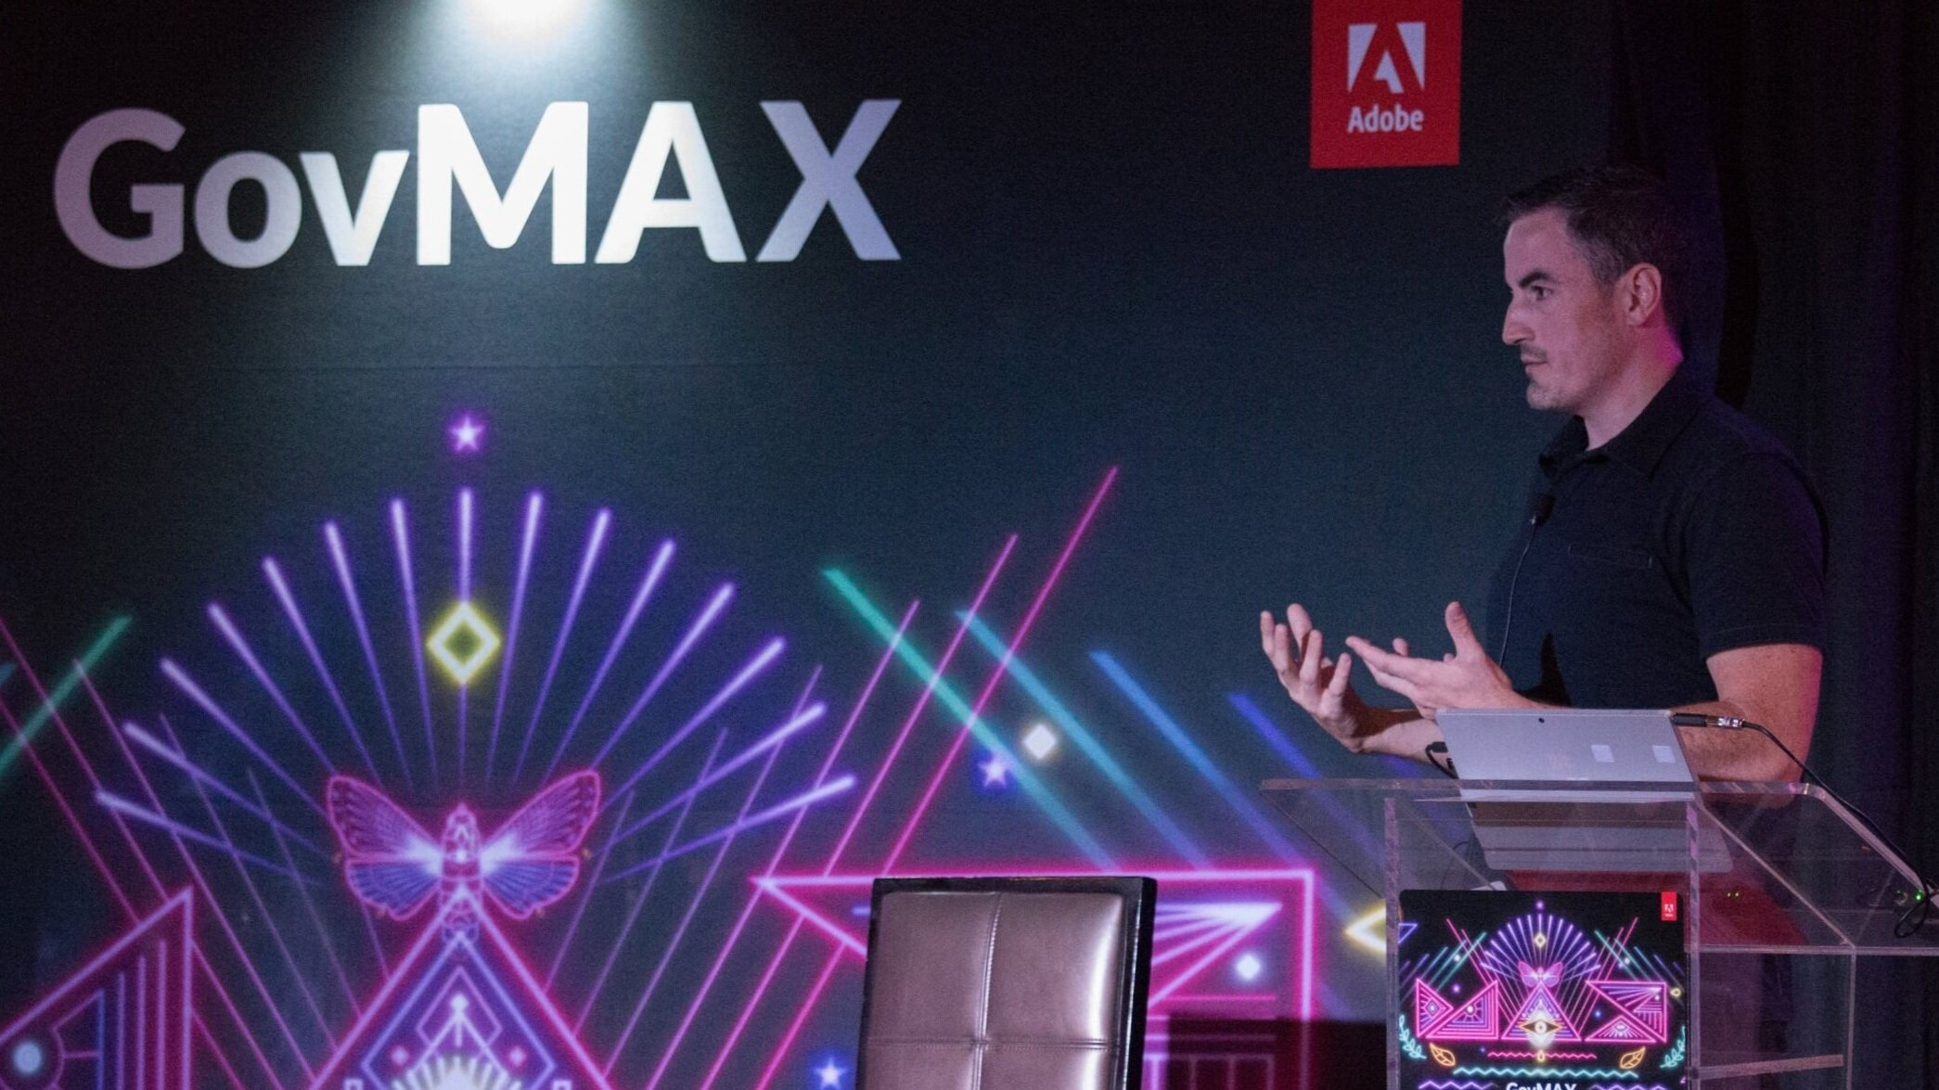
Who we are, why we can do it
z
Notes:
Blake and I have over 30 years of combined experience in military media, starting as combat photographers for the Air Force and Army, respectively, before becoming the top writers and content creators at WeAreTheMighty.com, launched in 2014 and recently purchased by Recurrent Media. Now, he’s an editor at the number 1 military website, Military.com, and I’m an editor at the number 1 military and veteran nonprofit, Fisher House Foundation. We have eight degrees between the two of us, including my recently earned MS of entertainment business. Between our credentials, our standing with the military audience, and our connections at brands not pursuing a livestream play, we are confident competitors will struggle to emulate our success. We are used to creating these and similar creative works from our homes.

Slide 7
Marketing
Partnered content and media appearances
Social Media
Podcasts and YouTube
Website
E-Mail Newsletter
Twitch
Funnel
Budget
Performance Indicators
Notes:
Our goal is to attract audience members, funnel them toward the Twitch channel and email newsletter, and ensure that our community and content is as sticky as possible so that they stay with us month after month. This effort is mainly about making great content, but we have budgeted up to $17,500 per month to advertising as the company grows to gain market share.

Slide 8
Timeline
Current
Podcast & Social Media
Within 6 months
YouTube & Website
Within 12 months
Twitch
2023 Q3
Email Newsletter
Notes:
Currently, the company is in a nascent stage as we build the first podcast and the social media that supports it. We’re also laying the groundwork for the initial YouTube video releases to take place this calendar year and for a website launch that will tie those products together. Through next year, this will lead to the launch of the Twitch channel and email newsletter.

Slide 9
Financials
 | Year 1 | Year 2 | Year 3
Total Net Sales | $93,998 | $747,234 | $1,837,350
Expenses * | $198,887 | $487,196 | $1,027,582
Profits (loss) | ($104,888) | $260,037 | $809,768
before taxes
z
Notes:
The first year is expected to see a substantial loss as we spend capital on production equipment and build audiences to a sustainable level. After that, profits are expected to grow healthily as audiences and media products grow.

Slide 10
Funding
Equity financing
$225,000
80/20 rule
Equipment purchases, marketing, and the initial production of YouTube and Twitch content

Slide 11
Long-Term Strategy
Build portfolio and deep bench
Open to buyout after year 3

Slide 12
Conclusion
Thank you. We Welcome your questions.

